Slide 1

Virtual Reality
A Gaming Controller for Counter Strike
Team ID: 51
Team Name: Pura Complete Karenge :P
Members: Pulkit Goyal | Arka Sadhu
Clubs: Electronics

Slide 2
Introduction
Well, we all play games…
Consider an example: What do you prefer? Playing FIFA with the keyboard or with a gaming controller. Obviously, the general opinion is a gaming controller.
Won’t it be awesome to have something which helps you play games which doesn’t support a gaming controller. For example: Counter Strike.
Imagine yourself to be in the game and actually shooting with a gun, and having a headgear which will project everything to going on the computer to right on your eyes. Now that is our project, Virtual Reality.

Slide 3
Our Project
The end product will be kind of a gaming console which will enable the user to play Counter Strike.
The gaming console will consist of a real gun, a headgear set with headphones. The gun will consist of most of the controls required for the game. The headgear, will be a kind of box, with a LCD module, the MPU-6050 sensor, an Arduino UNO. Also the headgear will have output HDMI and USB ports to be connected to the PC.
During the gameplay, the person in the game will be controlled by the user using actual head movements and gun thus giving a real feel of playing.

Slide 4
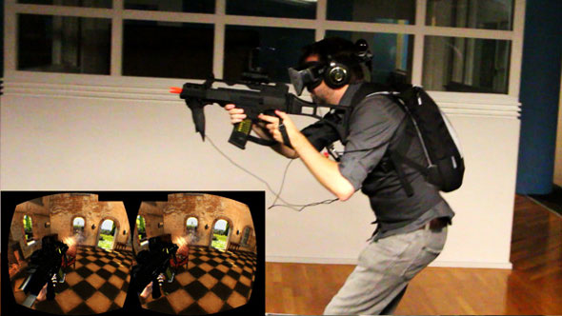
What our project will be like

Slide 5
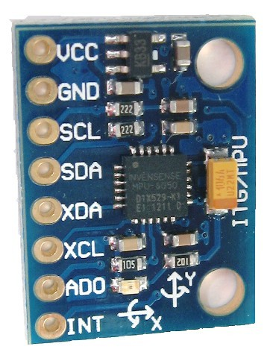
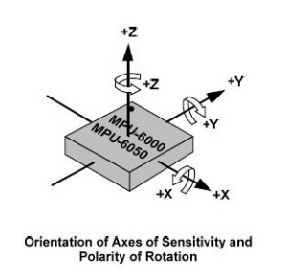
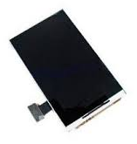
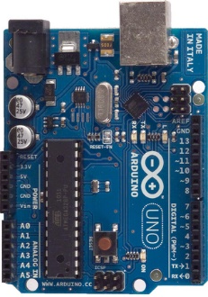
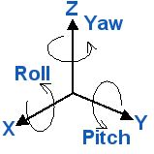
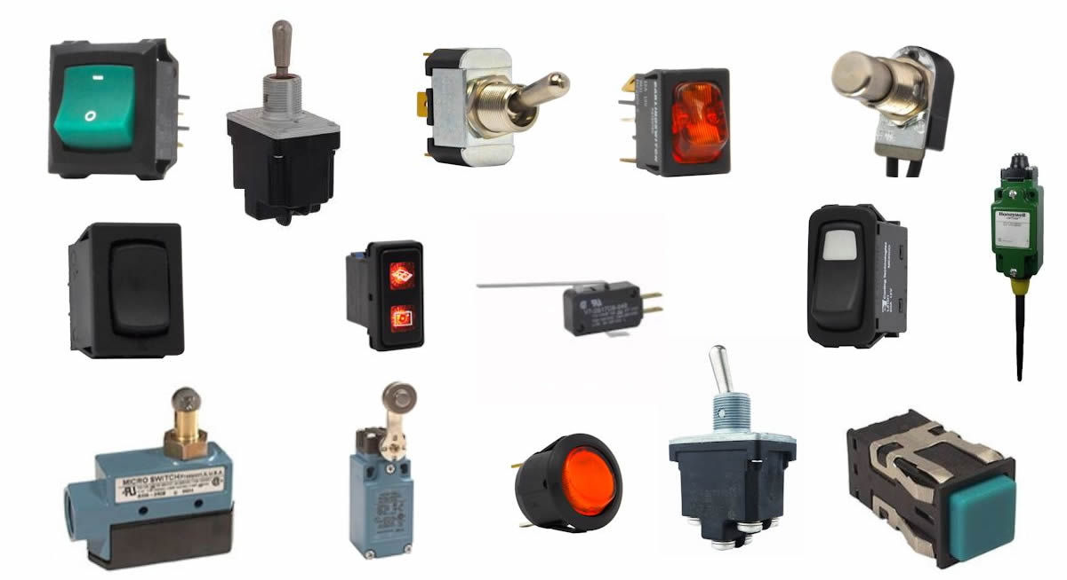
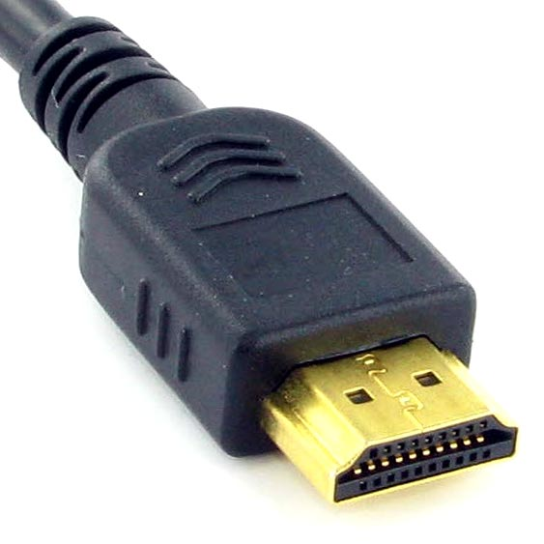
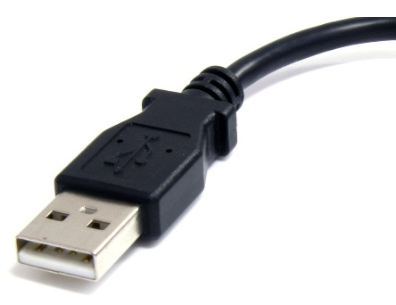
Components used

Slide 6
What we have done so far
Using the 3 axis gyroscope/accelerometer, MPU-6050 and communicate via the I2C protocol to get the values of Roll, Pitch & Yaw to be printed on the screen.
Coding the atmega16u2 on the Arduino Uno using DFU (Device Firmware Update) programming and replacing the original Arduino firmware with a Mouse firmware/Keyboard firmware using the library LUFA (Lightweight USB Framework for AVRs).
Using the Yaw & pitch values of the MPU-6050 with the Arduino Uno along with a push button to control the movement of the user and the gun shoot in the game.

Slide 7
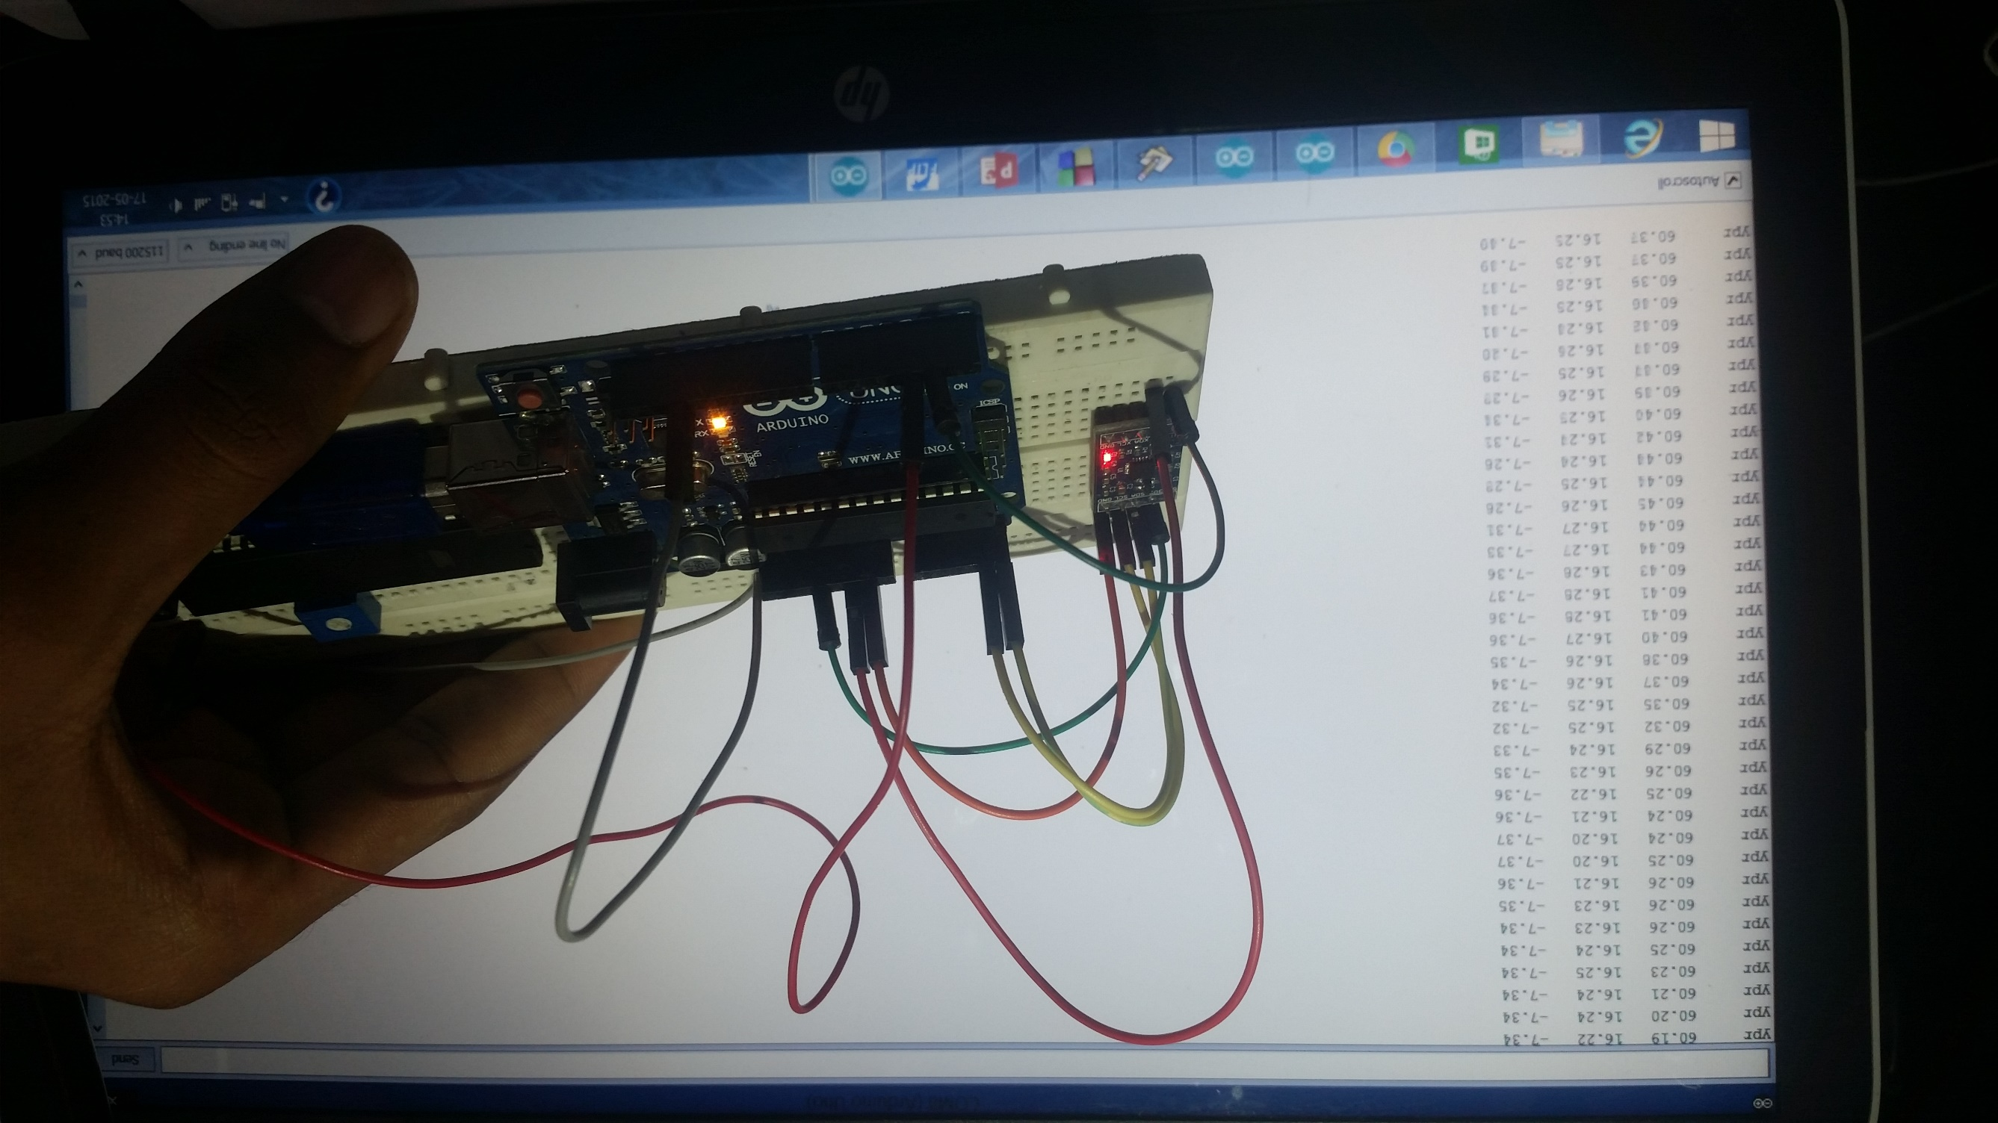
Yaw, Roll & Pitch displayed

Slide 8
Live Demo

Slide 9
What we’ll do later
Try to combine both mouse and keyboard firmwares so that a single Arduino can control the complete game, thus reducing the size and cost of the project.
Get the HDMI output of the PC and project the display on the LCD (altered as shown previously) and sound in the headphone.
Connect appropriate switches or other input methods for different controls of the game with a gun at appropriate locations so that the game is easy to play.
Complete the assembly of the headgear (LCD, MPU-6050, Arduino, Headphones) and connect it to the gun along with output HDMI and USB ports.

Slide 10
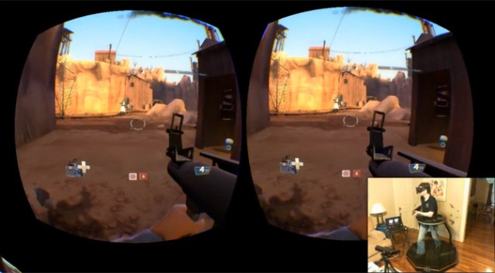
The LCD display

Slide 11
Learning in the project
To use accelerometer/gyroscope and I2C protocol for its communication with the Arduino.
How and what the smaller microcontroller, atmega16u2 does in the Arduino Board and how we can use it to hack the Arduino and use it as other USB devices.
How HDMI works, how we can use it to get output from a PC to display in an external LCD and sound in a headphone.
How the screen output is altered in Oculus Rift, Google Cardboard so that we get a 3D effect when seen.

Slide 12
Difficulties & Limitations
Haven’t been able to figure out which LCD to use and how to communicate to the LCD module via an HDMI Cable.
Don’t really know whether combining both the mouse/keyboard firmwares would be possible.
Calibration of the mouse movement so that it perfectly suits the motion of the player with the motion in the game.
Blurriness of the display because of it being too close (less than the least distance of vision) and lack of resources for the appropriate lenses.
Since the MPU-6050 is mounted on the headgear, the gun in the game will follow the user’s head and not the gun in the user’s hand, thus creating problems.

Slide 13
Scope (the actual scope) for improvement
Making wireless communication between the PC, gun and headgear for easy movement during the game.
Using appropriate lenses (such as those used in Oculus Rift) for focusing of the LCD display.
Using techniques such as image processing, thus capturing what the player is actually doing and using it to control the game.
Using microcontrollers directly instead of using Arduino, thus reducing the size and cost of the project.

Slide 14
Thank you!

